Slide 1

Online shopping
Batch-86
Team :B
This case study is on e-commerce mobile application
Presented by
Hanumantha Reddy
Poojitha Unnam
Roshini MohanKumar
Sandhya Lokesh

Slide 2
MOBILE SHOPPING
FOR USER :User can Search for required Product, it will display product results if the product is present else it will display “No matching records found”
DB MANAGER : The db manager is used for connecting to database
By using this module we can get the required data from the database like mobile details

Slide 3
Main class
Ui part of the project were the user registers / logins
Inputs like :
Firstname
Lastname
Phone number
Address line
Data processing :
All the methods are called here
Once the user login is successful the user can search for a particular mobile .The details of the mobile will be displayed and the product can be added to cart

Slide 4
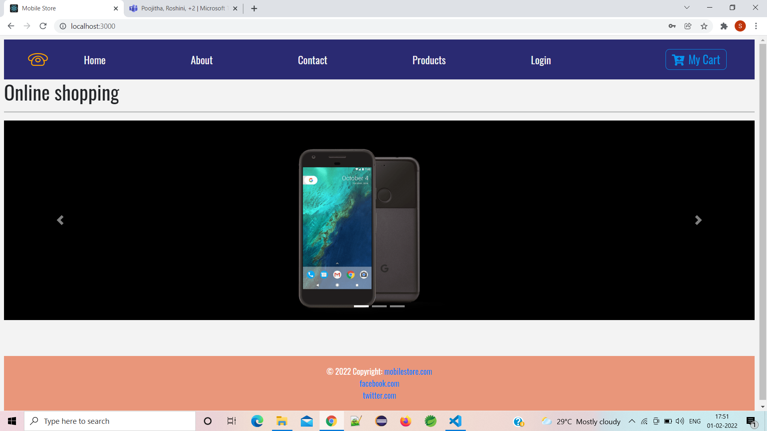
Home page

Slide 5
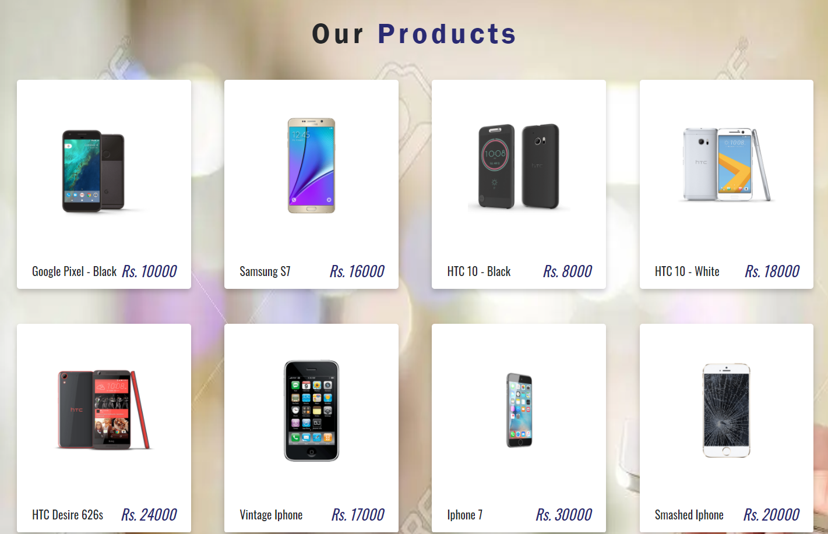
View products

Slide 6
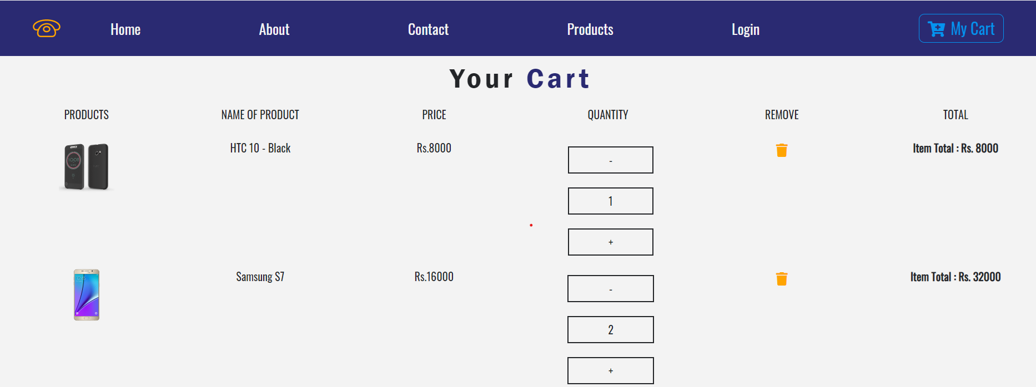
Cart details

Slide 7
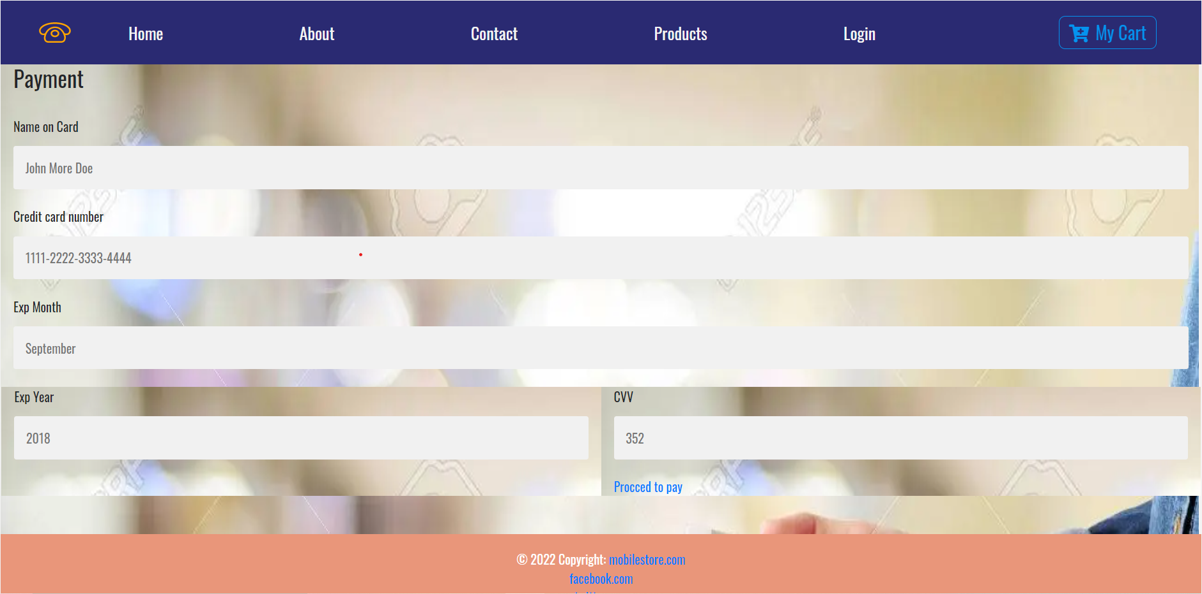
payment

Slide 8
Thank you

